Slide 1
SELECT Statements

Slide 2
The SELECT statement
Used to query the database
Retrieves information from the database
Does not change anything in the database
Made up of two parts (clauses) the SELECT and the FROM
SELECT information to retrieve
FROM tablename;

Slide 3
SELECT what… FROM where
We can SELECT column values… FROM a tablename
Show the product name and lines from the products table
SELECT productName, productLine
FROM products;
We can SELECT all values…FROM a tablename
Show all the information in the products table.
SELECT *
FROM products;
Both the SELECT and FROM are mandatory in a basic select statement.

Slide 4
Filtering the information
WHERE – specifies a condition
The WHERE clause limits the change to the areas that we specifically wanted.
It acts as a filter
It is optional (without it all values will be selected or update or deleted)
It is all about true conditions
Show the product name and line for all products that are motorcycles
SELECT productName, productLine
FROM products
WHERE productLine = 'Motorcycles';

Slide 5
Comparison Operators
= means equal to
<> means not equal to
< means less than
> means greater than
<= means less than or equal to
>= means greater than or equal to
Select all the information for products that are not motorcycles
SELECT *
FROM products
WHERE productLine <> 'Motorcycles’;
Select everything that costs less than 40 dollars
SELECT *
FROM products
WHERE MSRP < 40;

Slide 6
What about strings?
Select all the customer information where the last name starts with the letter a and b
SELECT *
FROM customers
WHERE contactLastName < ‘C';
For numbers it is the standard numeric sequence, for strings it is alphabetical.

Slide 7
LIKE operator
The LIKE operator implements pattern matching
WILDCARDS
The % looks for one or more characters before
The _ looks for one character
Select all the customer information for customers who’s last name starts with the word Ash
SELECT *
FROM customers
WHERE contactLastName LIKE 'Ash%';

Slide 8
BETWEEN
Tests a range
Get all the information from the products table for items that can be bought for 100 – 200 dollars
SELECT *
FROM products
WHERE buyPrice BETWEEN 100 AND 200;

Slide 9
COMPOUND CONDITIONS
The AND … OR.. Conditions
Select all information where the vendor is Second Gear Diecast for Vintage Cars
SELECT *
FROM products
WHERE productVendor = 'Second Gear Diecast' AND productLine = 'Vintage Cars’;
returns results only where both conditions are met in the same record
Select all the information for products that are classic cars and vintage cars
SELECT *
FROM products
WHERE productLine = 'Classic Cars' OR productLine = 'Vintage Cars’;
Returns results where either of the conditions are met

Slide 10
Compounding things a little further…
Combining AND and OR… AND takes precedence over OR
SELECT *
FROM products
WHERE productLine = 'Classic Cars' OR productLine = 'Planes' AND MSRP < 100;
This statement is evaluated like:
SELECT *
FROM products
WHERE productLine = 'Classic Cars' OR (productLine = 'Planes' AND MSRP < 100);
Use parenthesis to get the results that you want
SELECT *
FROM products
WHERE (productLine = 'Classic Cars' OR productLine = 'Planes’) AND MSRP < 100;

Slide 11
IN condition
Used to check a list of values
SELECT *
FROM products
WHERE productLine IN ('Planes', 'Trains', 'Ships');
Or you can see what is NOT in a list of values
SELECT *
FROM products
WHERE productLine NOT IN ('Planes', 'Trains', 'Ships');

Slide 12
Creating Order

Slide 13
ORDER BY
We have talked about the records in a table being unordered – their position in the table does not signify importance or order
We can control the output – the order that information is displayed upon retrieval
The ORDER BY clause helps to ensure that the result set is returned in a specified sequence

Slide 14
ORDER BY
It is ALWAYS the last clause in a SELECT statement
Consists of the ORDER BY clause followed by the sort key
SELECT columns
FROM table
ORDER BY sort_column [ASC|DESC];
The sort_column is the sort key – the column that information will be ordered by
ASC means ascending (lowest to highest)
DESC means descending (highest to lowest)
If no sort direction is listed, ascending is the default

Slide 15
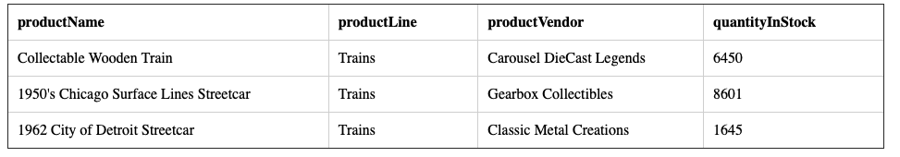
ORDER BY
SELECT productName, productLine, productVendor, quantityInStock
FROM products
WHERE productLine = 'Trains';

Slide 16
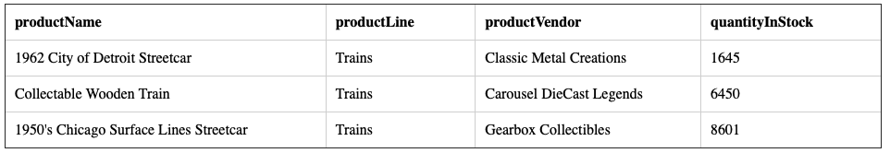
ORDER BY
Show the trains we have – show the product name, the line, the vendor and the quantity in stock from the least to most (ASC is the default)
SELECT productName, productLine, productVendor, quantityInStock
FROM products
WHERE productLine = 'Trains'
ORDER BY quantityInStock;

Slide 17
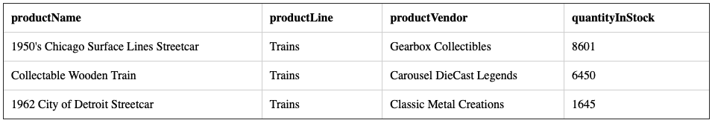
ORDER BY
Show the trains we have – show the product name, the line, the vendor and the quantity in stock from the most to the least
SELECT productName, productLine, productVendor, quantityInStock
FROM products
WHERE productLine = 'Trains'
ORDER BY quantityInStock DESC;

Slide 18
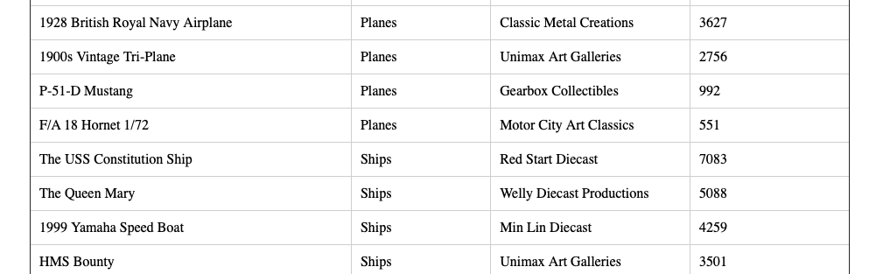
ORDER BY – multiple columns
Show the products we have – show the product name, the line, the vendor and the quantity in stock from the least to most and show them by category in alphabetical order
SELECT productName, productLine, productVendor, quantityInStock
FROM products
ORDER BY productLine ASC, quantityInStock DESC;

Slide 19
ORDER BY
Insert some records in a table – empty string, word, Word, 2 and 123
SELECT *
FROM order_test
ORDER BY order_string;
4
1 | 123
5 | 2
2 | word
3 | Word
Numerical data sorts from smaller to larger
String data sorts alphabetically
Temporal data sorts chronologically

Slide 20
Sorting
Three(3) factors affect sorting speed
The number of rows selected (more rows, slower sorting)
Number of columns in the ORDER BY clause (more columns, slower sorting)
Length of columns (longer the columns, slower the sorting speed)
Recommend restricting the sort to the minimum number of rows required.
The sort column does not have to appear in the list of columns, but without it there is no reference for the order

Slide 21
Dealing with NULLS

Slide 22
Testing for Nulls
Remember that Nulls represent missing or unknown values
Nulls do not satisfy specific conditions
LIKE, BETWEEN, IN and WHERE can’t find NULLS
IS NULL will check for Null conditions
Show all information where there is no state value
Show all information where there is a state value
SELECT *
FROM offices
WHERE state IS NULL;
SELECT *
FROM offices
WHERE state IS NOT NULL;

Slide 23
Checking for nulls
The COALESCE() function returns the first non-null expression
Same as checking with a Case expression if the value is not null and if it is, then apply the else statement
SELECT city, phone, addressLine1, COALESCE(state, 'N/A'), country, postalCode
FROM offices;

Slide 24
Matching Patterns

Slide 25
Matching Patterns
Like is useful if you don’t know the exact value – you retrieve information based on partial information
LIKE only works with character strings – not numbers or datetimes
Show all the employees with a first name that has any two letters followed by rr and any other characters.
SELECT firstName, lastName
FROM employees
WHERE firstName LIKE '__rry%';

Slide 26
Using an Alias

Slide 27
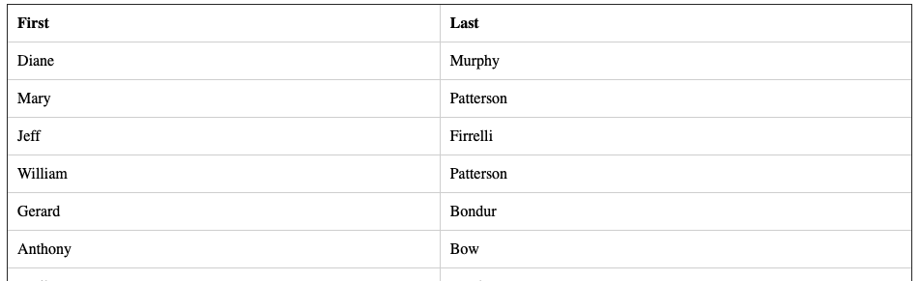
ALIASES
SELECT firstName AS First, lastName AS Last
FROM employees;

Slide 28
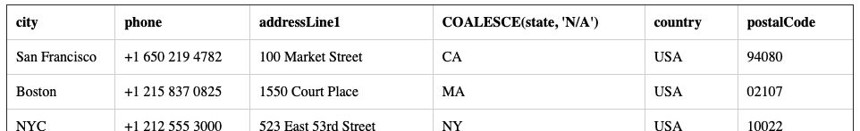
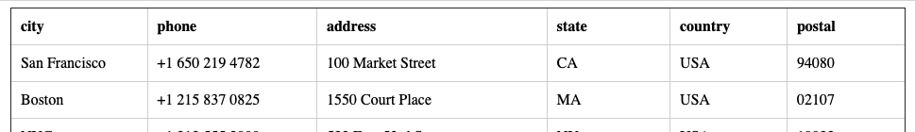
ALIASES
SELECT city, phone, addressLine1, COALESCE(state, 'N/A'), country, postalCode
FROM offices;
SELECT city, phone, addressLine1 AS address, COALESCE(state, 'N/A') AS state , country, postalCode AS postal
FROM offices;

Slide 29
Removing Duplicates

Slide 30
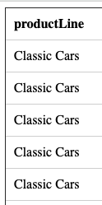
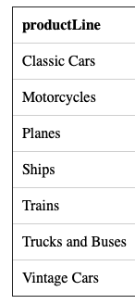
Eliminating Duplicate Rows
DISTINCT allows you to eliminate duplicate values
Show all the products
SELECT productLine
FROM products;
SELECT DISTINCT productLine
FROM products;
All nulls are considered duplicates and only one null will be returned

